Slide 1
Lecture 3
Dynamic RAM (DRAM)
Memory Refreshment

Slide 2
Introduction
Because of its ability to provide high storage capacity at low cost, dynamic RAM (DRAM) dominates the high-capacity memory applications, including the primary RAM in computers.
Further, as the name “dynamic” implies, the storage of information is inherently only temporary.
This need for refresh is the primary logical difference in the behavior of DRAM compared to SRAM.
We explore this logical difference by examining the dynamic RAM cell, the logic required to perform the refresh operation, and the impact of the need for refresh on memory system operation.

Slide 3
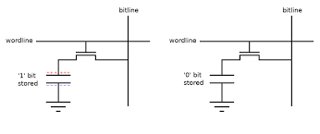
DRAM Cell
The dynamic RAM cell circuit is shown in Figure.
It consists of a capacitor C and a transistor T.
If sufficient charge is stored on the capacitor, it can be viewed as storing a logical 1, else a logical 0.
The transistor acts much like a switch.

Slide 4
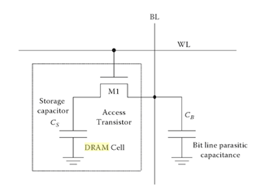
Cont.,
When the switch is “open,” the charge on the capacitor roughly remains fixed—in other words, is stored.
But when the switch is “closed,” charge can flow into and out of the capacitor from the external Bit (B) line.
This charge flow allows the cell to be written with a 1 or 0 and to be read.

Slide 5
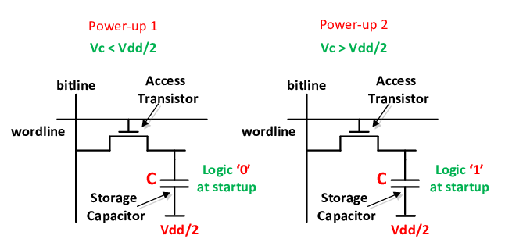
Cont.,
To reduce the time and power associated with moving charges from storage capacitor (Cs) to Bit-line capacitor (CBL), the CBL is charged to VDD/2.
If Vc> VDD/2 → Logic 1 was stored ,and vice versa.

Slide 6
Destructive & Non Destructive Memory Readout
A read operation that alters the contents of the accessed memory location and must be immediately followed by a rewriting of the contents in order to preserve them.
If the data in a memory is not destroyed in the reading process, the system has nondestructive readout.
A flip-flop is an example of nondestructive readout.
Sensing the output voltage (reading) from a given side of a flip-flop generally does not change the state of the flip-flop and the stored data is retained.

Slide 7
Dynamic RAM - Bit Slice Model
C is driven by Tri-state drivers
Sense amplifier is used to measure the minute change in voltage on the Bit-line.
Rewrite after Reading.
Array of sense amplifiers acts as a temporary data storage (Row Buffer).
Word
Select
select
0
B
D
Q
C
C
DRAM cell
Word
model
select
0
DRAM cell
Word
select
1
Word
Select
DRAM cell
select
2
n
2
1
D
Q
Word
select
C
DRAM cell
2
n
2
1
model
DRAM cell
Read/Write
logic
Sense
Data in
amplifier
Read/
Data out
Data in
Write
Bit
select
(b) Symbol
Write logic
Read logic
Data out
Read/
Bit
Write
select
(a) Logic diagram

Slide 8
Block Diagram of a DRAM

Slide 9
How to handle addressing in DRAMs
To reduce the number of pins, the DRAM address is split to roughly halve the large number of address pins on the typical RAM IC.
The row address first is used to select the row of cells to be read within the memory.
The column address secondly is used to select the word to be placed on the output from the data read from the row of cells.

Slide 10
Cont.,
This can be done since the row address, which performs the row selection, is actually needed before the column address, which reads out the data from the row selected.
In order to hold the row address throughout the read or write cycle, it is stored in a register.
The column address is also stored in a register.

Slide 11
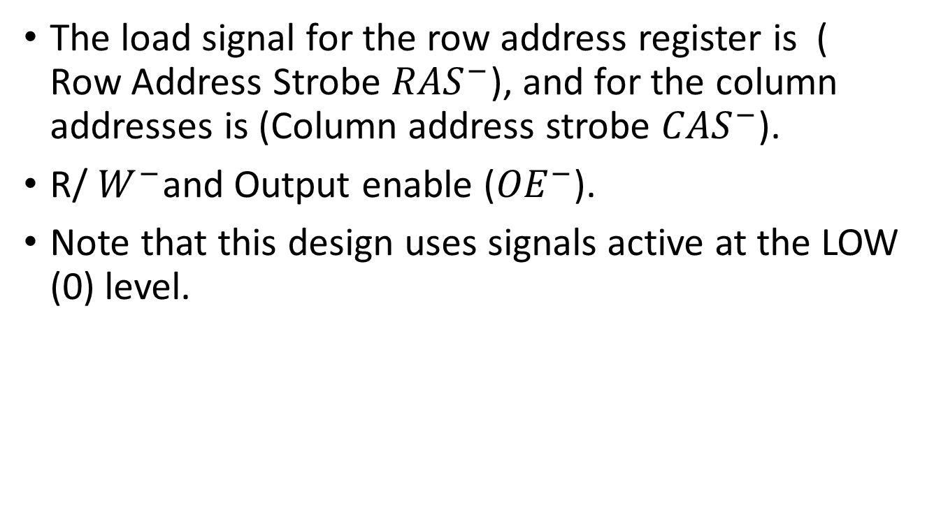
Control signals
The load signal for the row address register is ( Row Address Strobe ${RAS}^{−}$), and for the column addresses is (Column address strobe ${CAS}^{−}$).
R/ $W^{−}$and Output enable (${OE}^{−}$).
Note that this design uses signals active at the LOW (0) level.

Slide 12
Handle Row Address
The row address is applied to the address inputs.
RAS changes from 1 to 0,
loading the row address into the row address register.
This address is applied to the row address decoder and selects a row of DRAM cells.

Slide 13
Handle Column Address
The column address is applied,
Then CAS changes from 1 to 0, loading the column address into the column address register.
This address is applied to the column address decoder, which selects a set of columns of the RAM array of size equal to the number of RAM data bits.

Slide 14
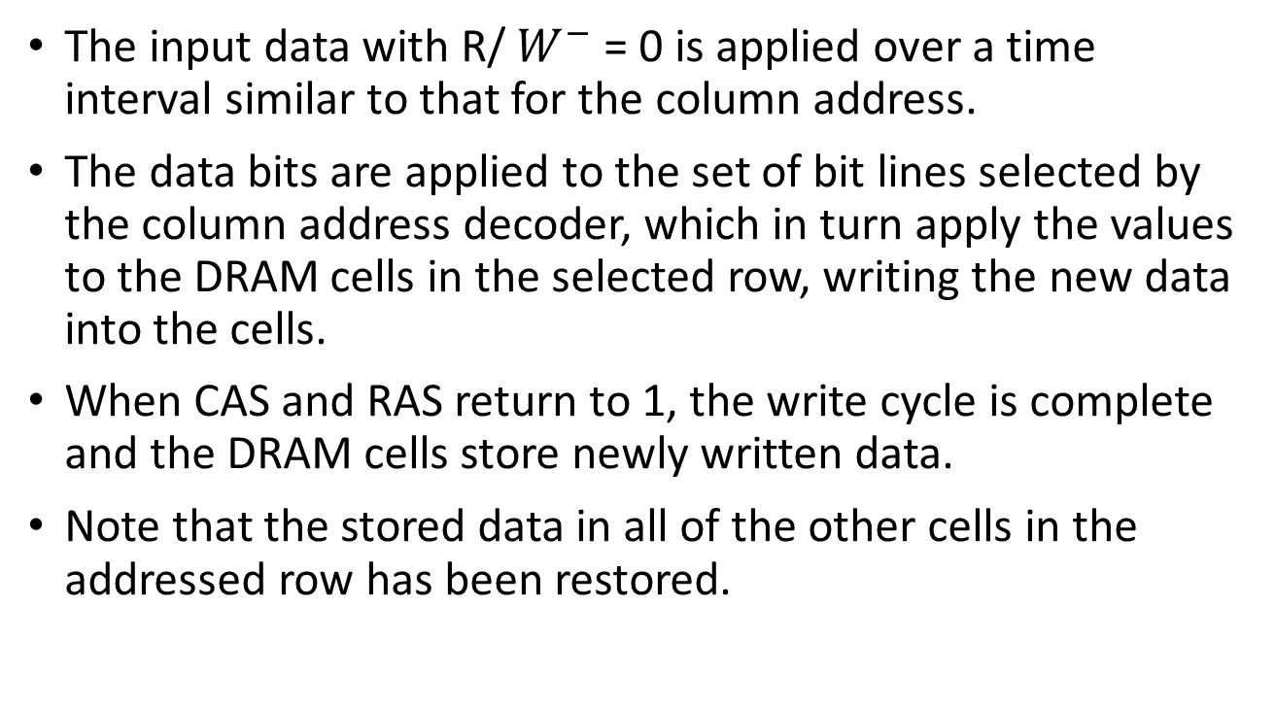
For Write Operation
The input data with R/ $W^{−}$ = 0 is applied over a time interval similar to that for the column address.
The data bits are applied to the set of bit lines selected by the column address decoder, which in turn apply the values to the DRAM cells in the selected row, writing the new data into the cells.
When CAS and RAS return to 1, the write cycle is complete and the DRAM cells store newly written data.
Note that the stored data in all of the other cells in the addressed row has been restored.

Slide 16
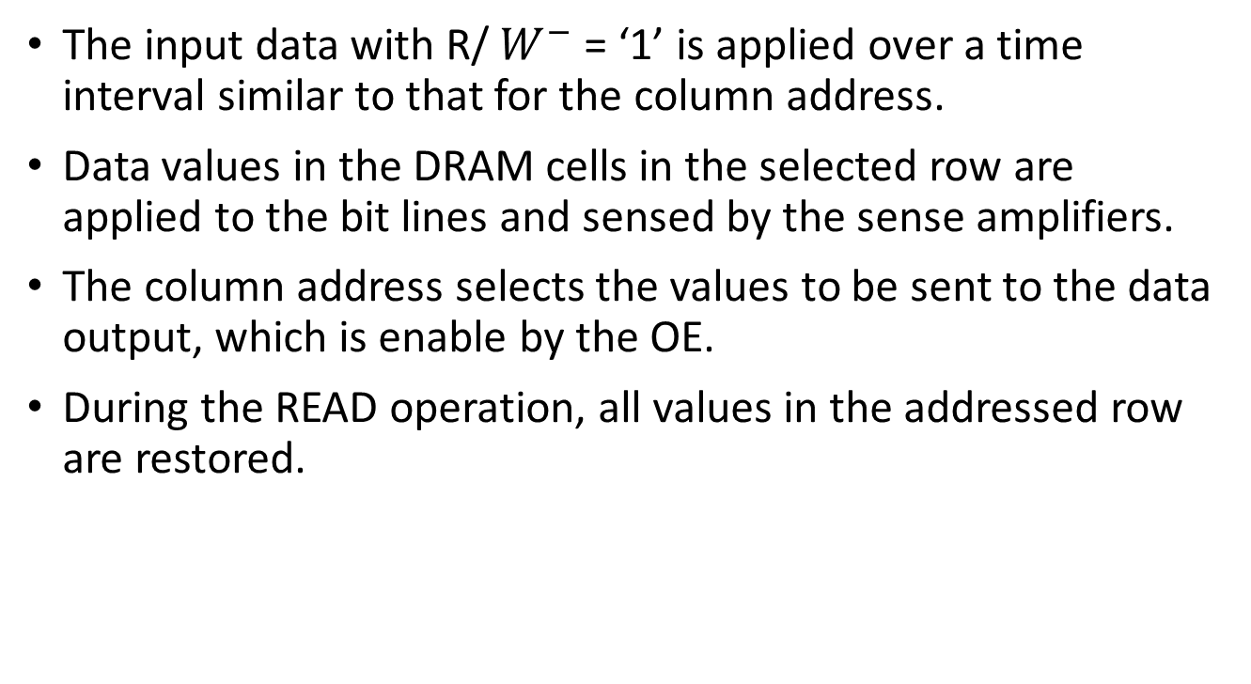
For READ Operation
The input data with R/ $W^{−}$ = ‘1’ is applied over a time interval similar to that for the column address.
Data values in the DRAM cells in the selected row are applied to the bit lines and sensed by the sense amplifiers.
The column address selects the values to be sent to the data output, which is enable by the OE.
During the READ operation, all values in the addressed row are restored.

Slide 17
Dynamic RAM Read Timing
20 ns
Clock
T1
T2
T3
T4
T1
Address
Row
Column
Address
Address
RAS
CAS
Output
enable
Read/
Write
Data
Hi-Z
Data valid
output
65 ns
Read cycle

Slide 18
Memory Refresh
Is the process of periodically reading information from an area of computer memory and immediately rewriting it to the same area without modification.
Each memory refresh cycle refreshes a succeeding area of memory cells, and repeatedly refreshing all the cells in a consecutive cycles.
The refreshment process is conducted automatically.

Slide 19
Cont.,
While a refresh cycle is occurring, the memory is not available for normal READ & WRITE operations.
In modern memories, this overhead time is not large enough.
Conclusion: each memory cell must be refreshed repetitively within a maximum interval between refreshes specified by the manufacture.

Slide 20
Block Diagram of a DRAM Including Refresh Logic

Slide 21
How Refresh Works?
1- Refresh cycles are generated by refresh counter( either a refresh counter; as a part of the memory or external counter as a part of DRAM controller), which contains the address of the row to be refreshed.
2- The row address is applied to the row address lines.
3- The refresh cycle can be triggered by one of the following ways: RAS-only refresh, CAS-before-RAS refresh, or Hidden refresh.

Slide 22
The standard triggering ways
RAS-only refresh. A row address is placed on the address lines and RAS is changed to 0. In this case, the refresh addresses must be applied from outside the DRAM chip, typically by an IC called a DRAM controller.
CAS-before-RAS refresh. The CAS is changed from 1 to 0 followed by a change from 1 to 0 on RAS.
It appears as an illegal operation. In this case, the incoming external row address will be discard , and the memory will use its internal refresh counter.
Additional refresh cycles can be performed by changing RAS by the internal counter without changing CAS.

Slide 23
Cont.,
Hidden refresh. Following a normal read or write, CAS is left at 0 and RAS is cycled, effectively performing a CAS-before-RAS refresh. During a hidden refresh, the output data from the prior read remains valid. Thus, the refresh is hidden. Unfortunately, the time taken by the hidden refresh is significant, so a subsequent read or write operation is delayed.
In all cases, note that the initiation of a refresh is controlled externally by using the RAS and CAS signals.

Slide 24
Refreshing Types
Refreshes may be performed at evenly spaced points in the refresh time, an approach called distributed refresh.
Alternatively, all refreshes may be performed one after the other, an approach called burst refresh

Slide 25
Example
A 4M × 4 DRAM has a refresh time of 64 ms and the length of time to perform a single refresh per row is 60 ns?
What is the refreshment time in case of distributed or burst refreshment.
What is the time for Read & Write.
Solution:
- no. of rows = 4096 rows to be refreshed.
A- Burst Refreshment:
- A total time out for refresh = 4096 x 60 ns = 0.25 ms
- The rest time for R/W = 64ms – 0.25 ms = 63.75 ms
The DRAM controller must initiate 4096 refreshes sequentially every 64 ms for burst refresh.

Slide 26
Cont.,
B- Distributed Refreshment
the refresh interval for distributed refresh = 64 ms/4096 = 15.6 microseconds (μs).
Time R/W = 15.6 μs – 60 ns
- The DRAM controller must initiate a refresh every 15.6 μs for distributed refresh
Since use of burst refresh would halt computer operation for a fairly long period, distributed refresh is more commonly used.

Slide 27
Assignment
The refresh cycle is similar to READ cycle, but executing faster, Why?

Slide 28
Sheet
Text book

